Slide 1



Community Mapping For Flood Resilience
Dar es Salaam, Tanzania
© Geoffrey Kateregga, Paul Uithol, Jeff Haack, Steven Bukulu

Slide 2
Dar Ramani Huria
OpenStreetMap
What is it used for?
How it Works (technically)
How People Map
The Data (what comes out)
Community

Slide 3
Dar Ramani Huria
Seasonal floods in Dar Es Salaam have enormous costs for the city in terms of lives, livelihoods, health, transportation, and infrastructure.

Slide 4
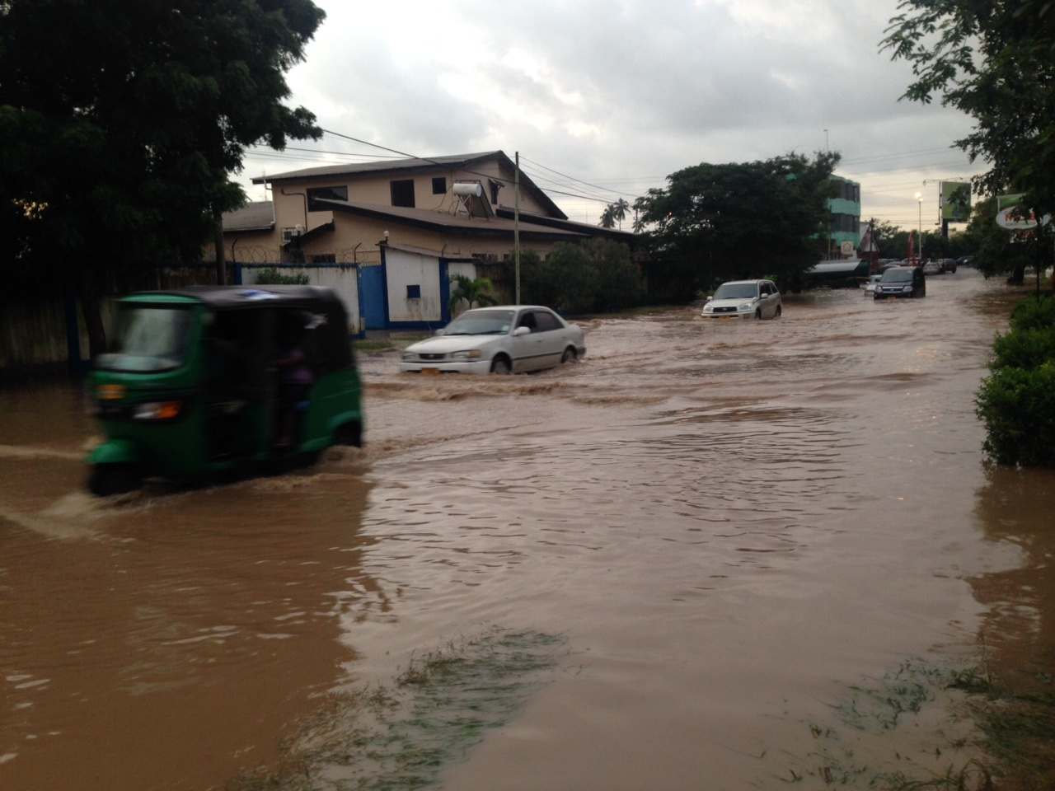

Slide 5
We are Mapping Dar es Salaam to...
Support Risk awareness activities related to Urban Flooding
Improve Understanding, Planning and Maintaining of Urban Infrastructure
Develop capacity for Risk Analysis through use of InaSAFE Software

Slide 6


Slide 7
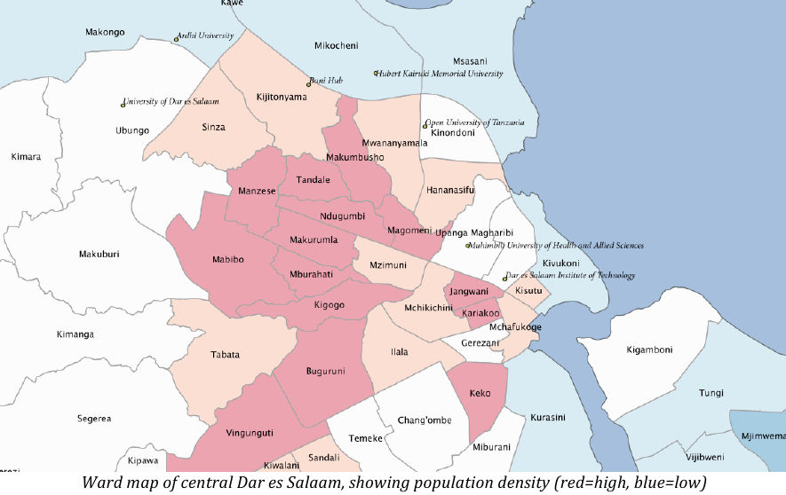
Dar es Salaam Population Density

Slide 8

What is OpenStreetMap?
OpenStreetMap (OSM) is a collaborative project to create a free editable map of the world
Created by Steve Coast in the UK in 2004, it was inspired by the success of Wikipedia

Slide 9
How does it work?
OpenStreetMap is built by a community of mappers that contribute and maintain data about roads, trails, cafés, railway stations, and much more, all over the world.

Slide 10
Volunteered Geographic Information (VGI)
Expand/Complete/Improve existing DBs, infrastructures, archives
Gather/Produce new forms of spatial information using local knowledge, informing previous unanswered questions, social, and political problems

Slide 11
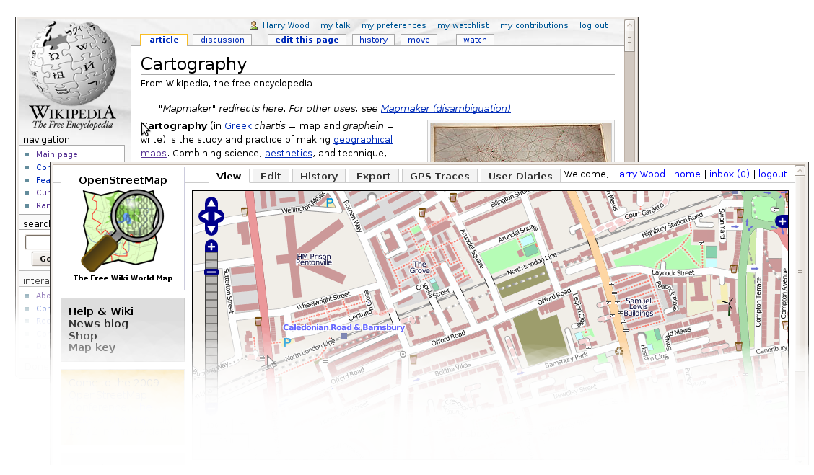
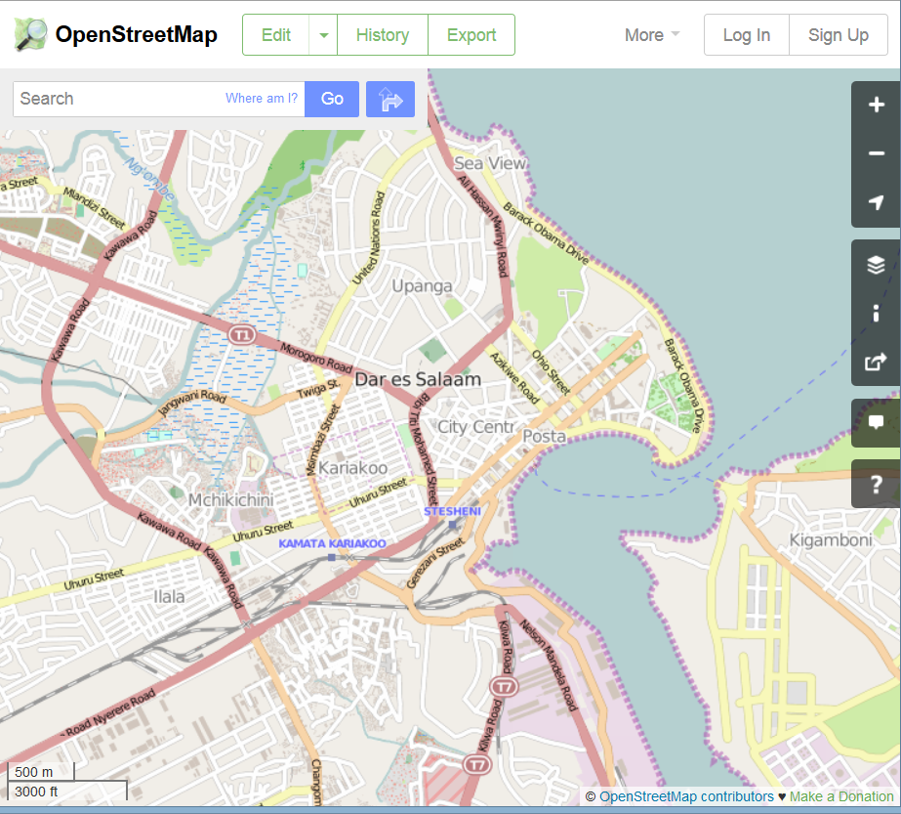
Wikipedia of Maps

Slide 12
Community driven
OpenStreetMap's community is diverse, passionate, and growing every day. Our contributors include enthusiast mappers, GIS professionals, engineers running the OSM servers. Humanitarians response Teams, and many more.

Slide 13
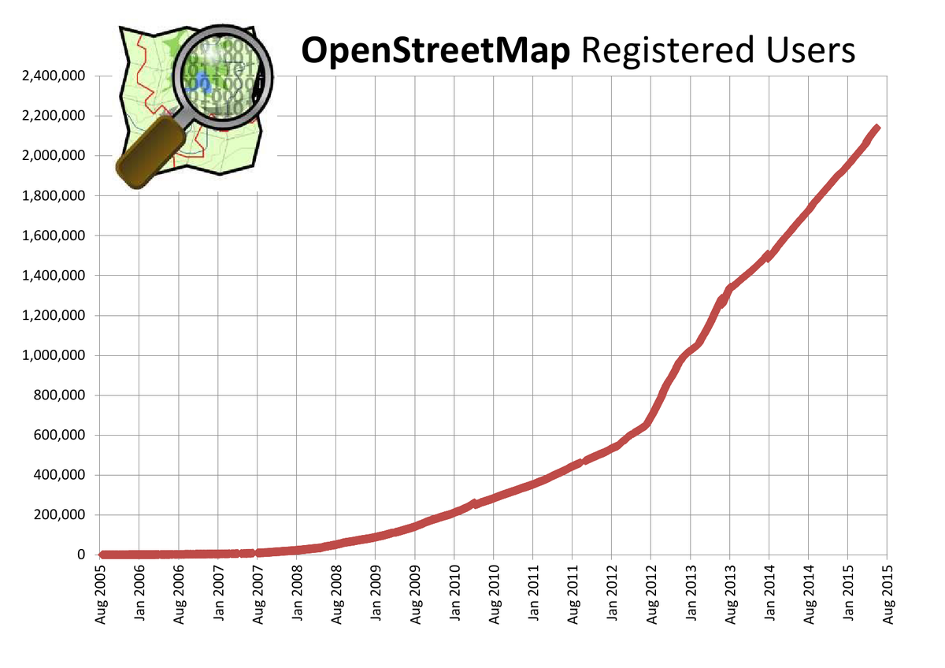
Community
http://wiki.openstreetmap.org/wiki/Stats

Slide 14
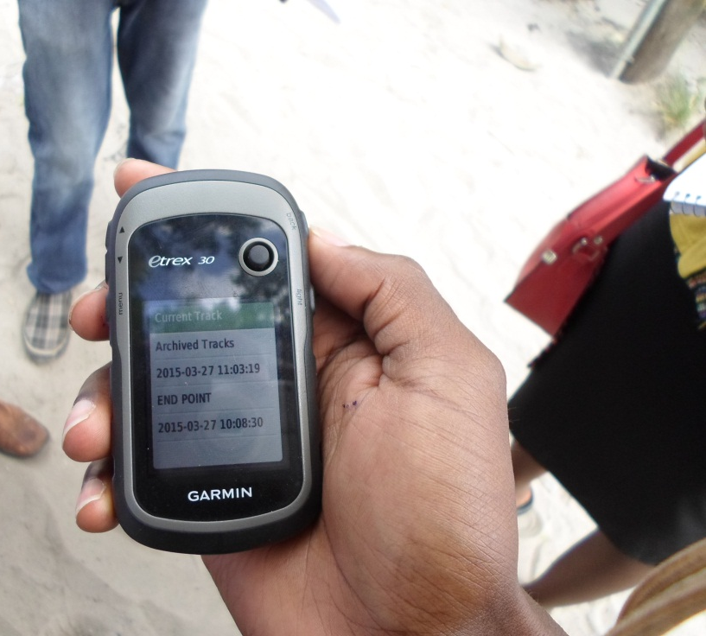
Local knowledge
Contributors use aerial imagery, GPS devices, and low-tech field maps to verify that OSM is accurate and up to date.

Slide 15
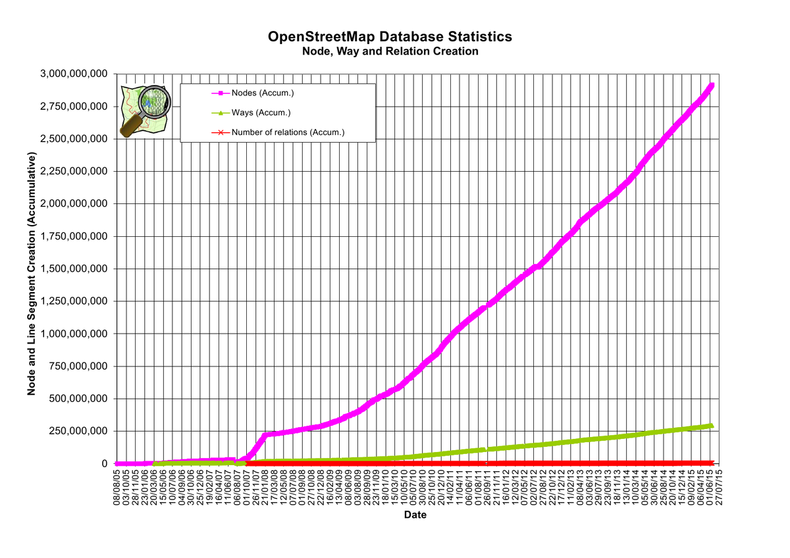
Data objects
http://wiki.openstreetmap.org/wiki/Stats

Slide 16
Open data
OpenStreetMap is open data: you are free to use it for any purpose as long as you credit OpenStreetMap and its contributors.

Slide 17
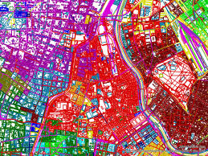
Free data
Accessible data
Self-corrective data
Compared to Google Maps which is Licensed; meaning that Google owns the data
OSM is owned by users
OSM is more accurate
OSM is more comprehensive

Slide 18
What can it be used for?
Anything…
Business
Humanitarian
Planning / Preparation
Communicating Issues / Problems

Slide 19
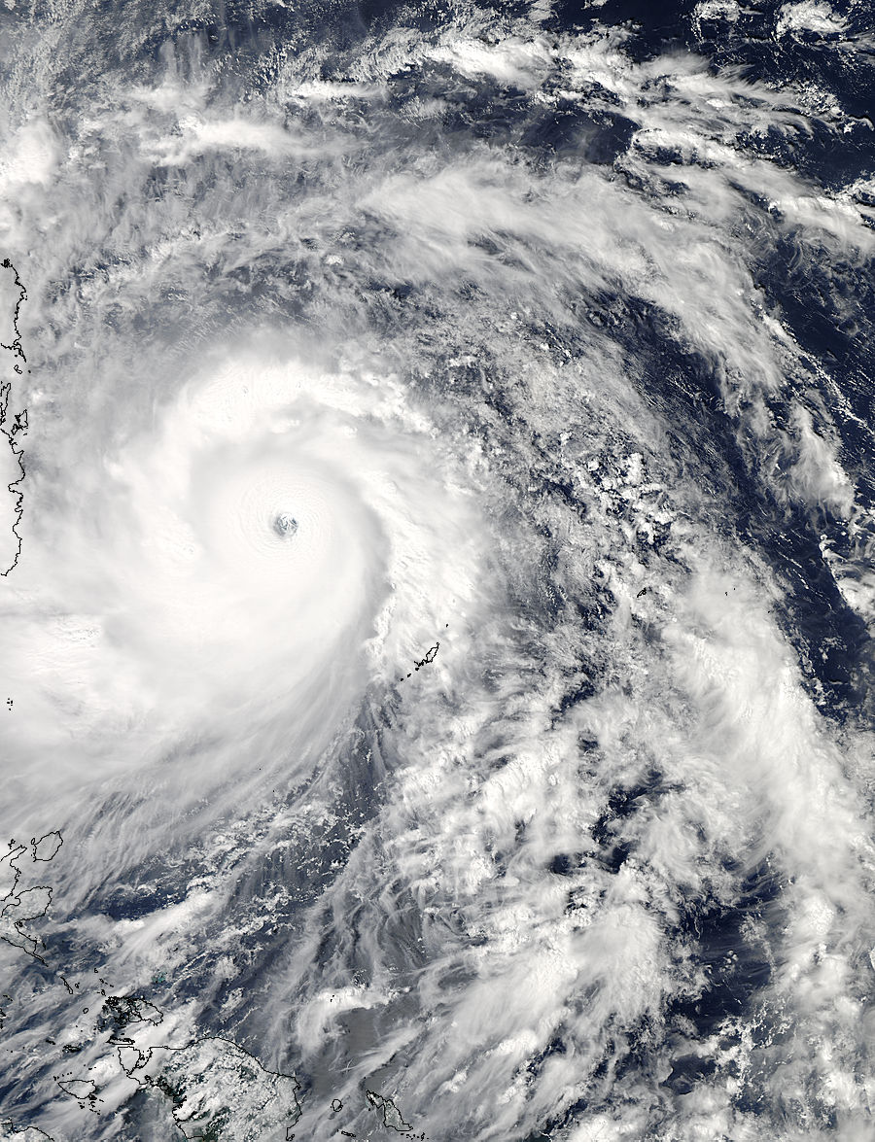
Humanitarian

Slide 20
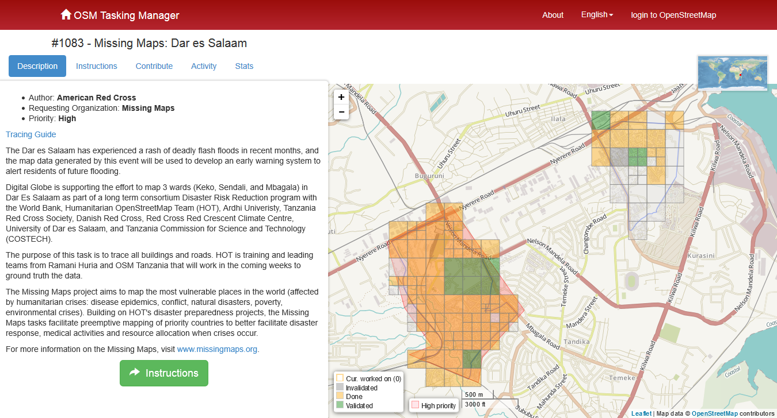
Humanitarian

Slide 21
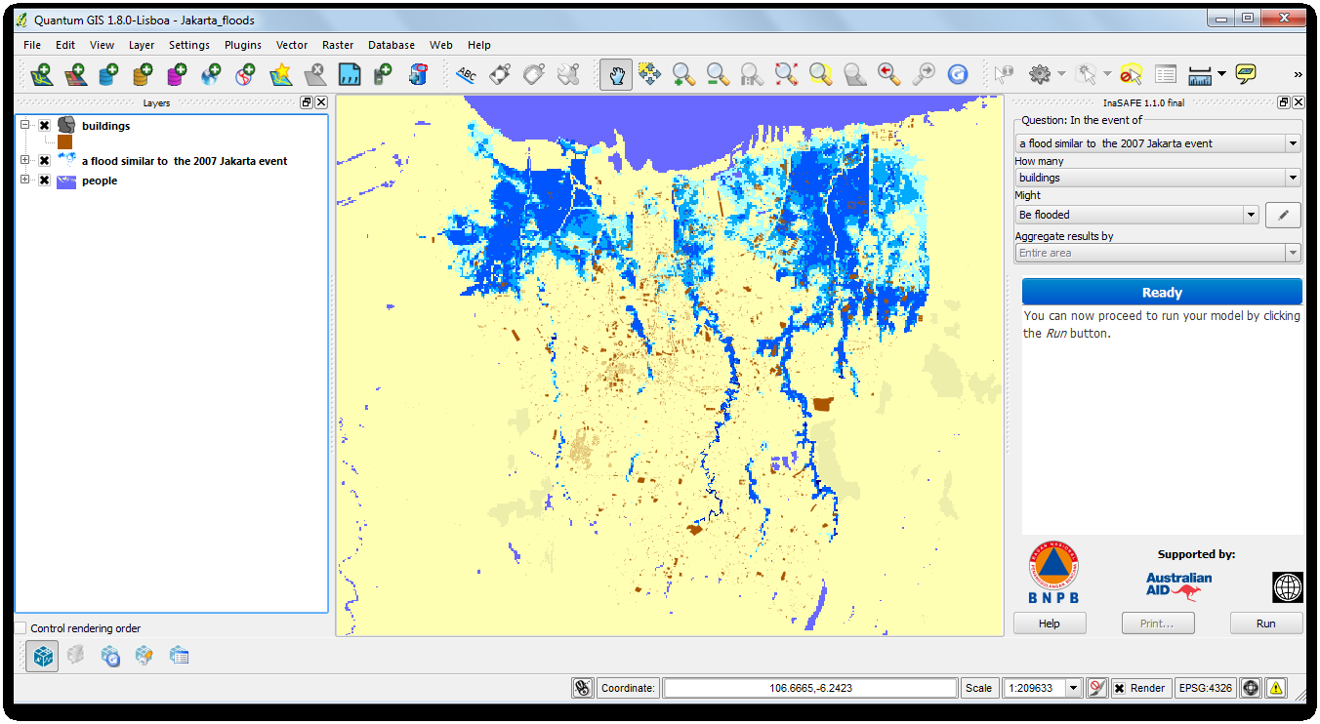
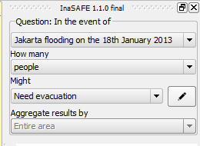
InaSAFE

Slide 22
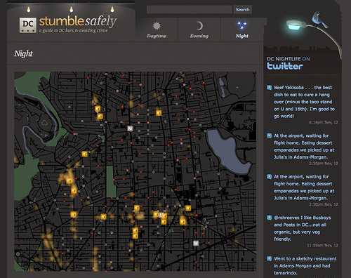
Communicating issues/problems

Slide 23
How does it work?
Geodata
Roads
Waterways
POIs
Buildings
… and more
Thousands of Users Editing
Open, Free Data (ODbL)

Slide 24
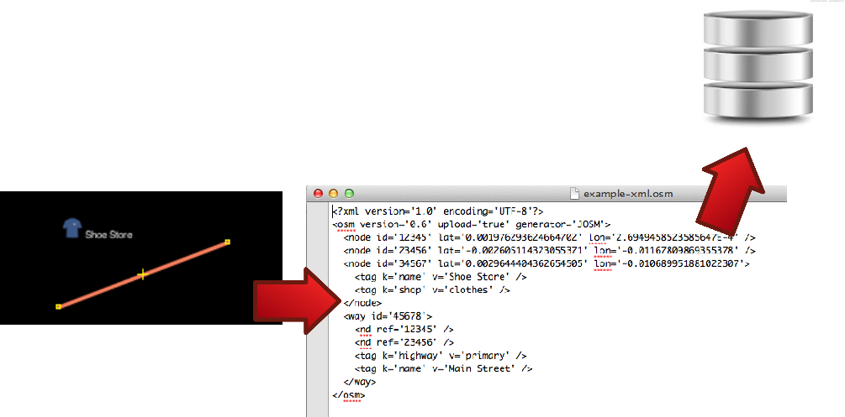
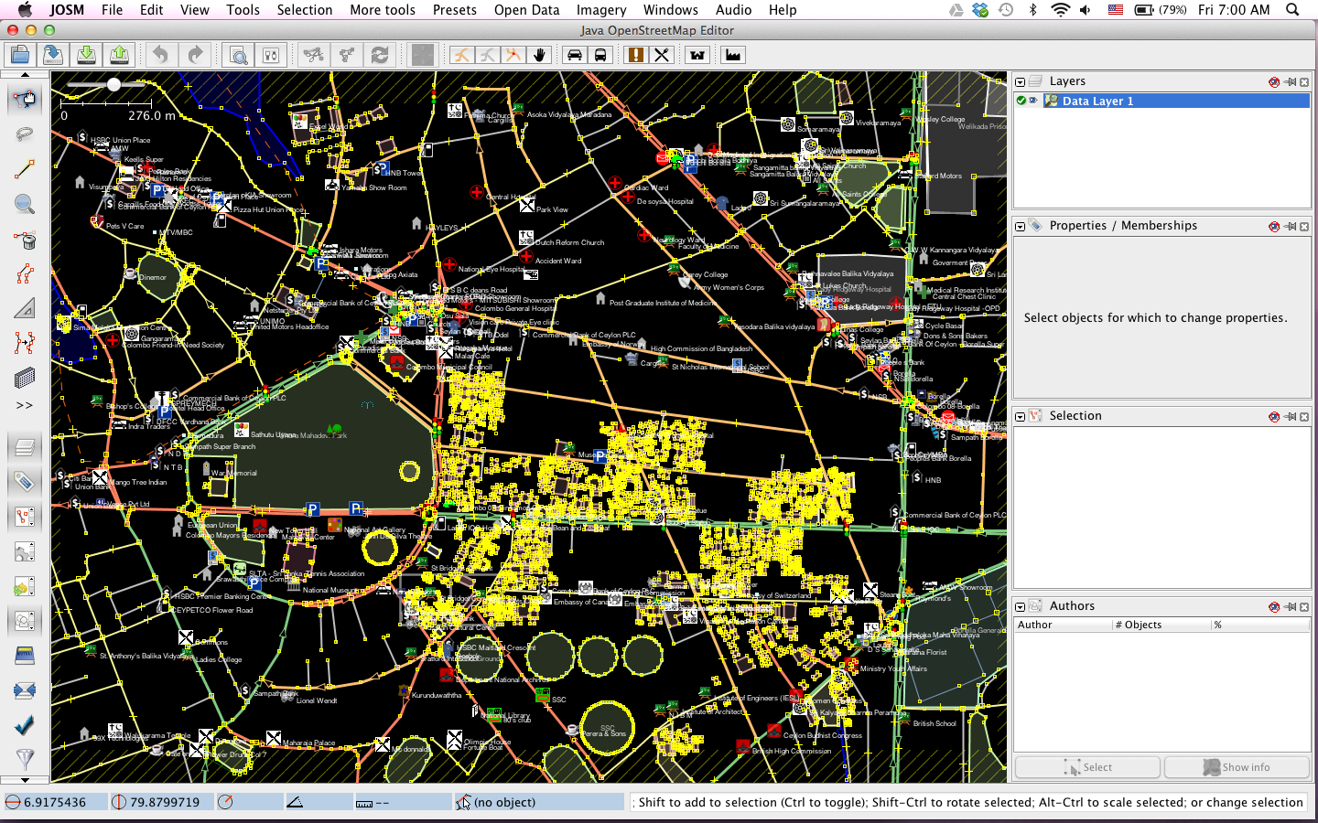
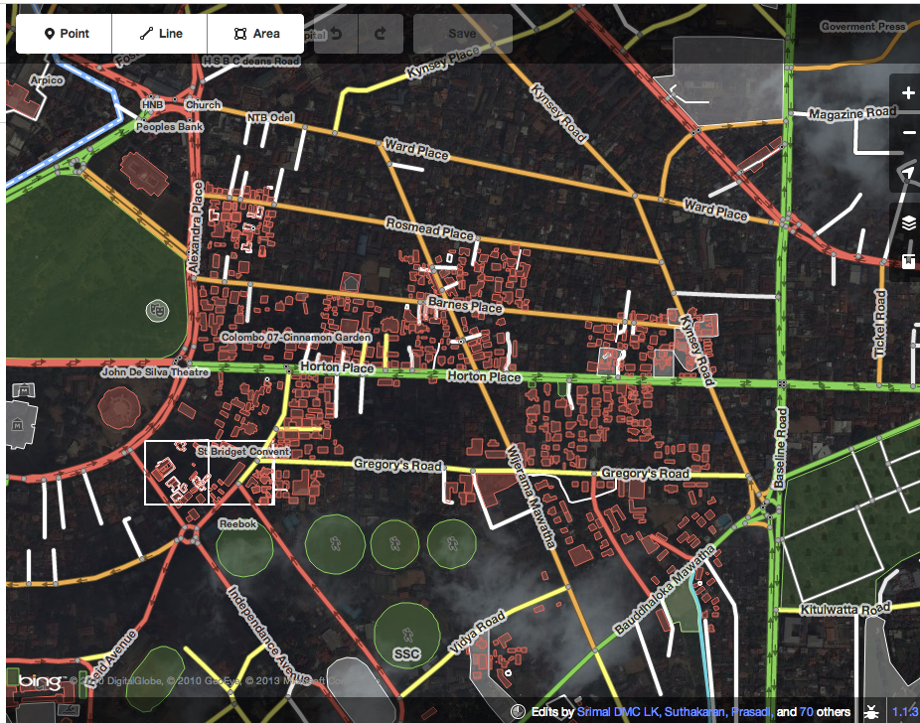
How does it work?
Multiple Editing Applications
Editing API (Data transmitted over XML)
(Application Programming Interface; defines how computer programs talk to each other)
Central Database

Slide 25
How do people map?
Trace Imagery
Go Outside
Report Bugs
Divide Tasks

Slide 26
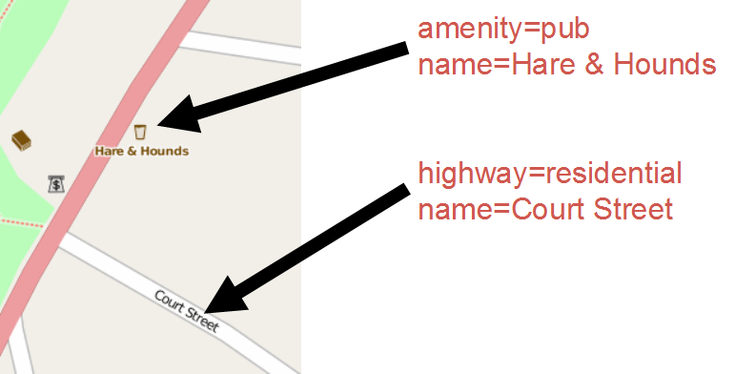
The data
All Vector Data
Free-tagging system
(meaning every object in the database can carry an unlimited number of attributes)

Slide 27
Our data model
drainage
stream, drain, ditch, culvert
sanitation
drinking water, water tank, public toilet
roads
tertiary, unclassified, residential, footway
buildings
residential, commercial, industrial
landuse
playground, wetland, park, cemetery
http://wiki.openstreetmap.org/wiki/Map_Features

Slide 28
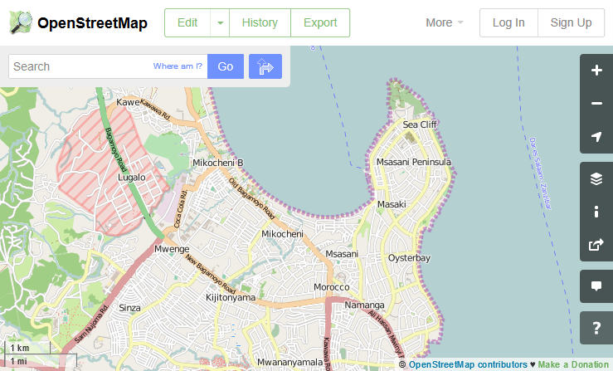
The map

Slide 29
Navigating the map
Dar es Salaam!
http://www.openstreetmap.org/#map=13/-6.7847/39.2538
Left mouse to drag the map
Mouse wheel to zoom

Slide 30
Create user accounts
Go to https://www.openstreetmap.org/user/new
Fill in email address, username, and password
Remember the password you’re using!
We have found yahoo mail to cause issues with confirmation email. Use gmail if possible.
Find the confirmation email, click the link to confirm
Log in

Slide 31
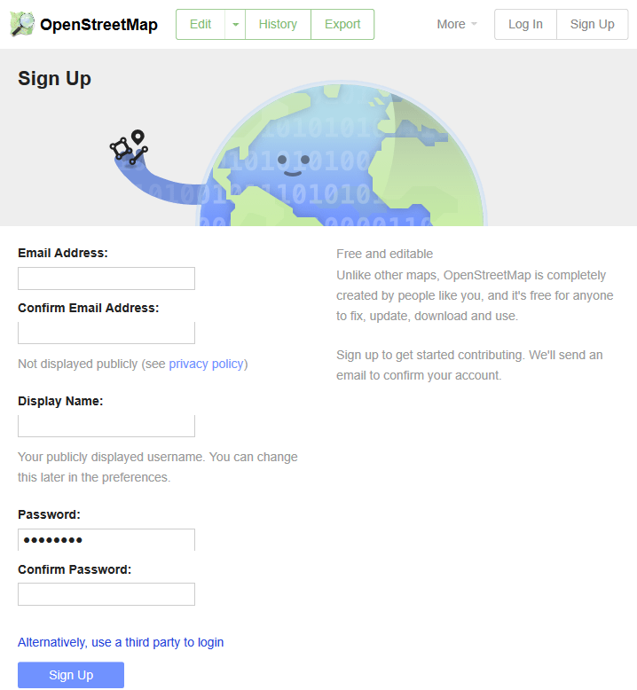

Slide 32
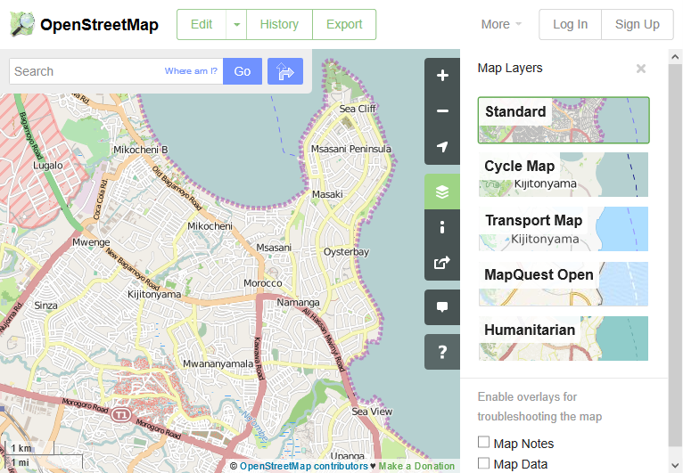
Map layers (standard)

Slide 33
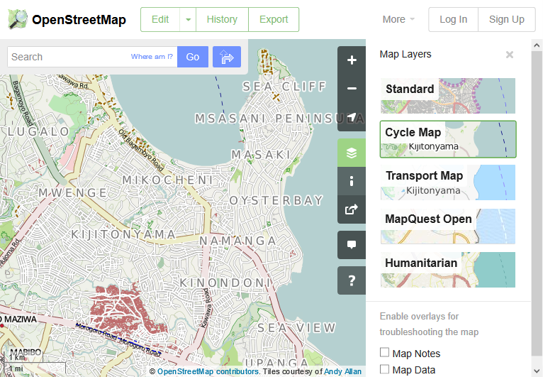
Map layers (cycle, and more)

Slide 34
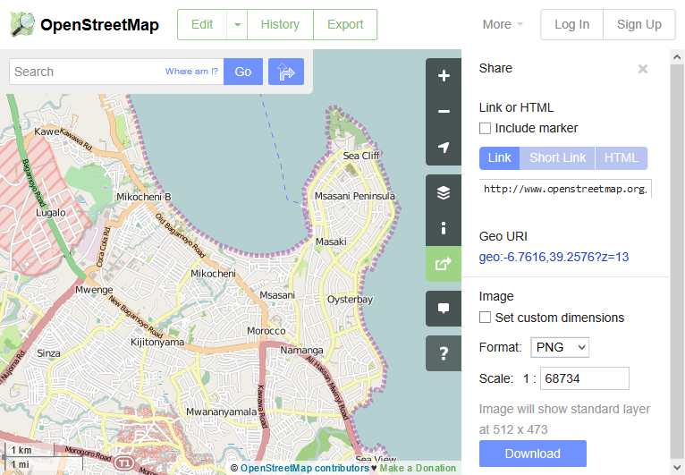
Share

